Slide 2




A New Open Source Foundation Developed in Partnership
The Academy Software Foundation provides a neutral forum for open source software developers in the motion picture and broader media industries to share resources and collaborate on technologies for image creation, visual effects, animation and sound.

Slide 3

ASWF created
01
Open Source Day
August 10, 2018
Founding members:
Animal Logic
Autodesk
Blue Sky Studios
Cisco
DNEG
DreamWorks Animation
Epic Games
Foundry
Google Cloud
Intel
SideFX
The Walt Disney Studios
Weta Digital
July 29, 2019
OpenTimelineIO
Netflix
Amazon Web Services
Rodeo FX
MovieLabs
First project
October 23,2018
OpenVDB
New members:
Sony Pictures Entertainment
Warner Bros.
Blender Foundation
Visual Effects Society
Today
Siggraph 2020
08
August 19-20, 2020
New members:
Unity Technologies
Conductor Technologies
SMPTE
05
September 13, 2019
Apple
Microsoft
April 16, 2020
Open Shading
Language
AMD
DockYard
02
February 8, 2019
OpenColorIO
06
$1M/year
03
May 1, 2019
OpenEXR
OpenCue
NVIDIA
ftrack
Red Hat
07
Scitech
Council
Open source
Investigation
concludes
04
COVID-19
May
August
Nov
Feb
May
August
Nov
Feb
May
August
Nov
2018
2019
2020

Slide 4






























Premier Members
General Members
Associate Members

Slide 5
Our Mission
Increase the quality and quantity of open source contributions by establishing a governance model, legal framework and community infrastructure that lowers the barrier to entry for developing and using open source software.

Slide 6
Our Goals
Provide a neutral forum to coordinate cross-project efforts, establish best practices and share resources.
Develop an open continuous integration (CI) and build infrastructure to enable reference builds from the community.
Streamline development for build and runtime environments through the sharing of open source build configurations, scripts and recipes.
Provide individuals and organizations with a clear path for participation and code contribution.
Provide better, more consistent licensing through a shared licensing template.
Create working groups for exploration of new or larger projects.
Focus on diversity and inclusion and raising the profile of software engineers in our industry.

Slide 7






Structure
TAC
Technical Advisory Council
Governing Board
Outreach Committee
OpenVDB
OpenColorIO
OpenEXR
OpenCue
OpenTimelineIO
Open Shading Language
Continuous Integration platform
Notes:
Neutral structure outside corporate firewalls
Overseen by a Governing Board responsible for making business decisions
Technical Advisory Council (TAC) includes ASWF members,
technical project representatives, and associated industry groups
and is responsible for:
establishing best practices and policies for the technical community
identifying any resource or development gaps
coordinating the community to address gaps
proposing new projects to the Governing Board
coordinating cross-project opportunities (e.g. a dev summit)
Each accepted technical project will operate independently and anyone (regardless of membership) may participate in or lead

Slide 8
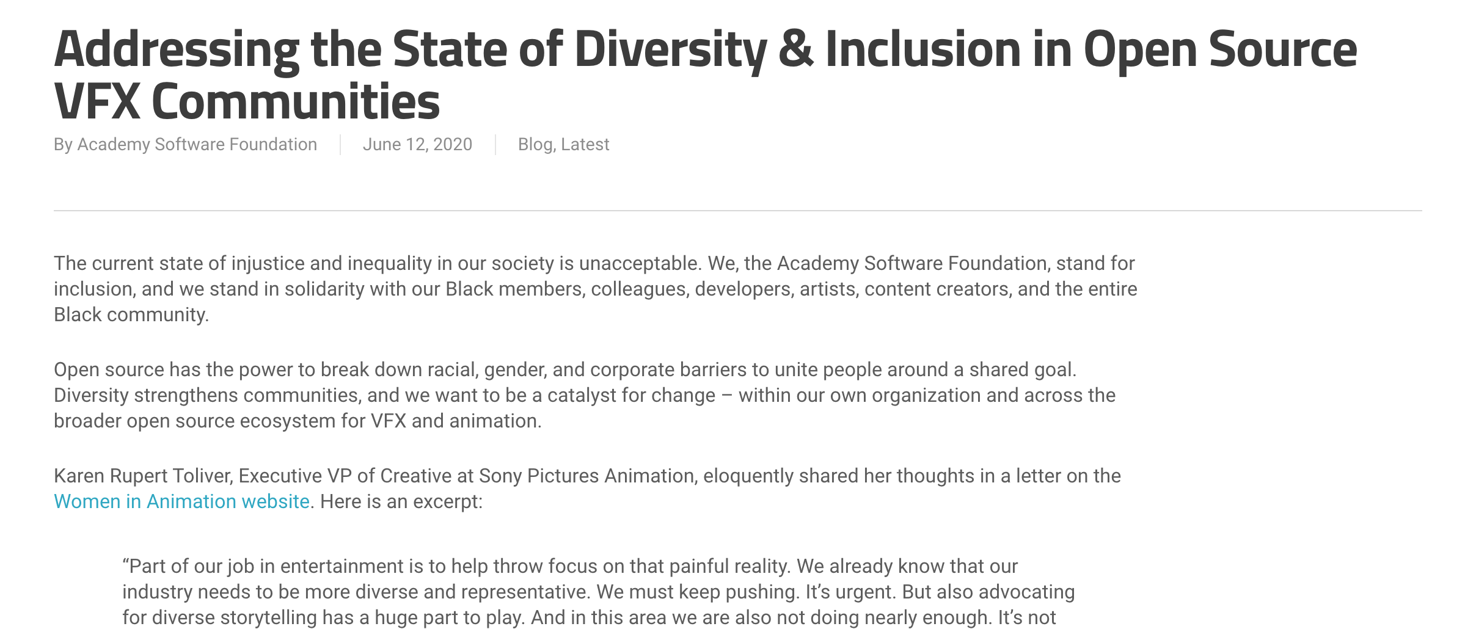
Diversity & Inclusion Working Group
Read more at aswf.io/diversity_inclusion.
Notes:
Kicked off June 17 with 39 attendees!
A mix of software engineers/developers, artists, marketing/comms, talent recruiters, and managers.
A cross-industry supported by studios and vendors – a greenfield opportunity.

Slide 9
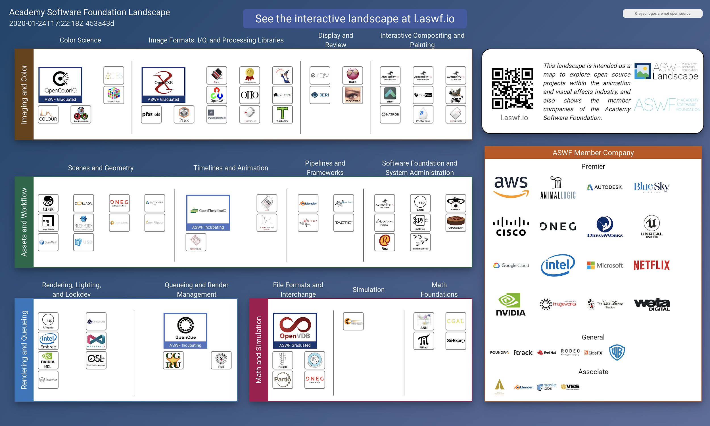
ASWF Landscape
https://l.aswf.io/
Public list of open source projects in the animation and VFX industry
Updates can be submitted via GitHub
Goal is to have all active, open source projects in animation and VFX industries represented.

Slide 10







Our Projects:
contributed by:
Dreamworks Animation
contributed by:
Sony Pictures Imageworks
contributed by: Google Cloud and
Sony Pictures Imageworks
Open Shading Language
contributed by:
Lucasfilm
contributed by:
Pixar Animation Studios
contributed by:
Sony Pictures Imageworks

Slide 11
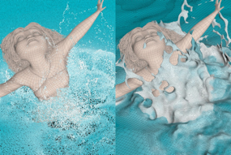
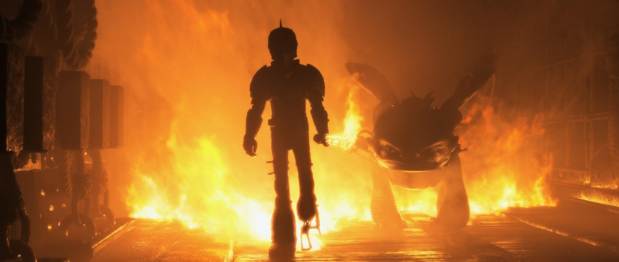

How to Train Your Dragon: The Hidden World; courtesy of DreamWorks Animation
The Croods; courtesy of DreamWorks Animation
First project adopted by ASWF in Sept. 2018; first project to graduate to adopted status in July 2019.
Developed by DreamWorks Animation in 2012.
C++ library for volumetric representations including fluid simulations, animated volumes and environmental effects.
Academy Technical Achievement Award recipient.
Key contributors include DreamWorks, Autodesk, DNEG, Industrial Light & Magic, NVIDIA, SideFX, Weta Digital.
github.com/AcademySoftwareFoundation/openvdb
Notes:
Used on films including Boss Baby, Trolls, The Croods, and How to Train Your Dragon: The Hidden World
Since joining:
Released v6.0, v6.1, v7.0 (above + bug-fixes & optimizations)
New collaborations (Autodesk/Nvidia)

Slide 12
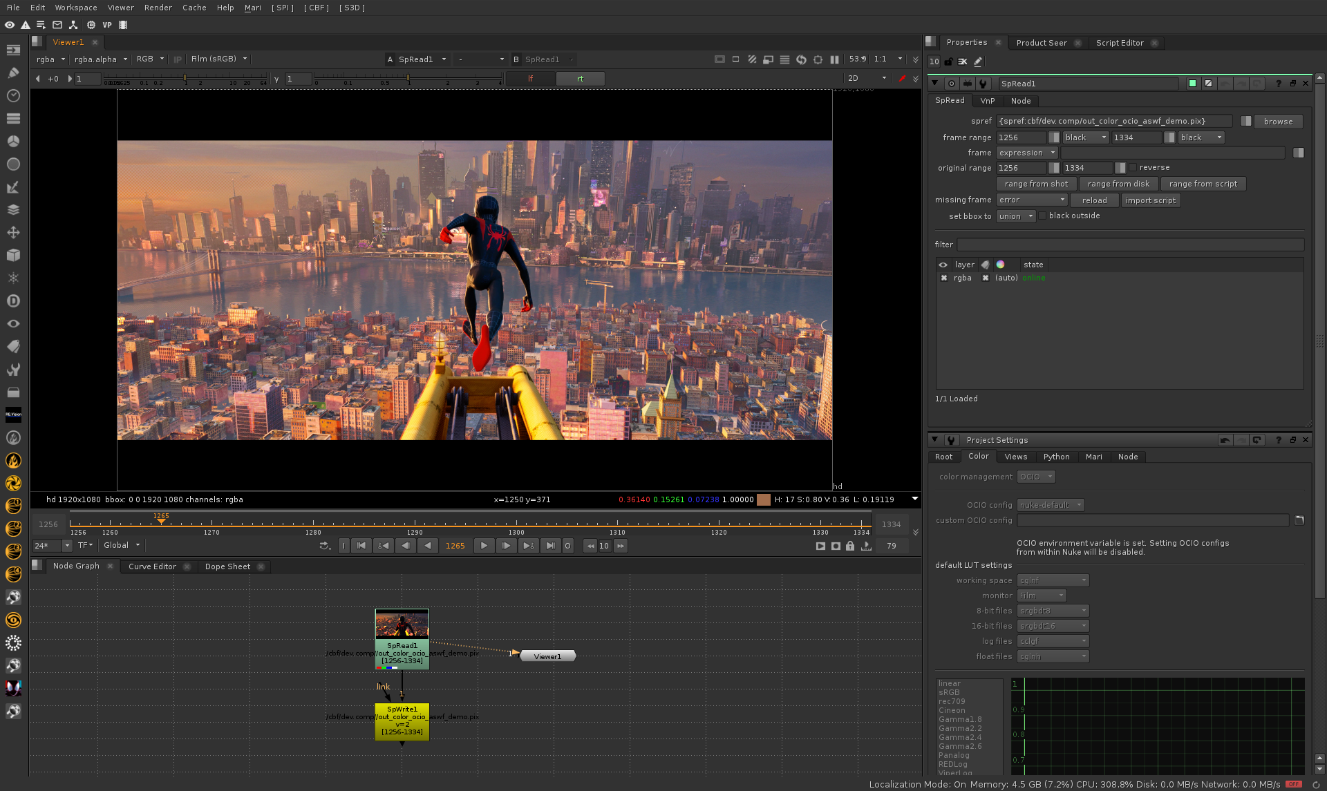
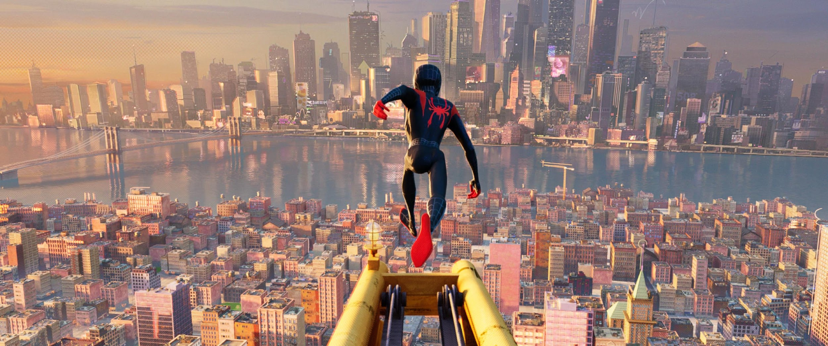
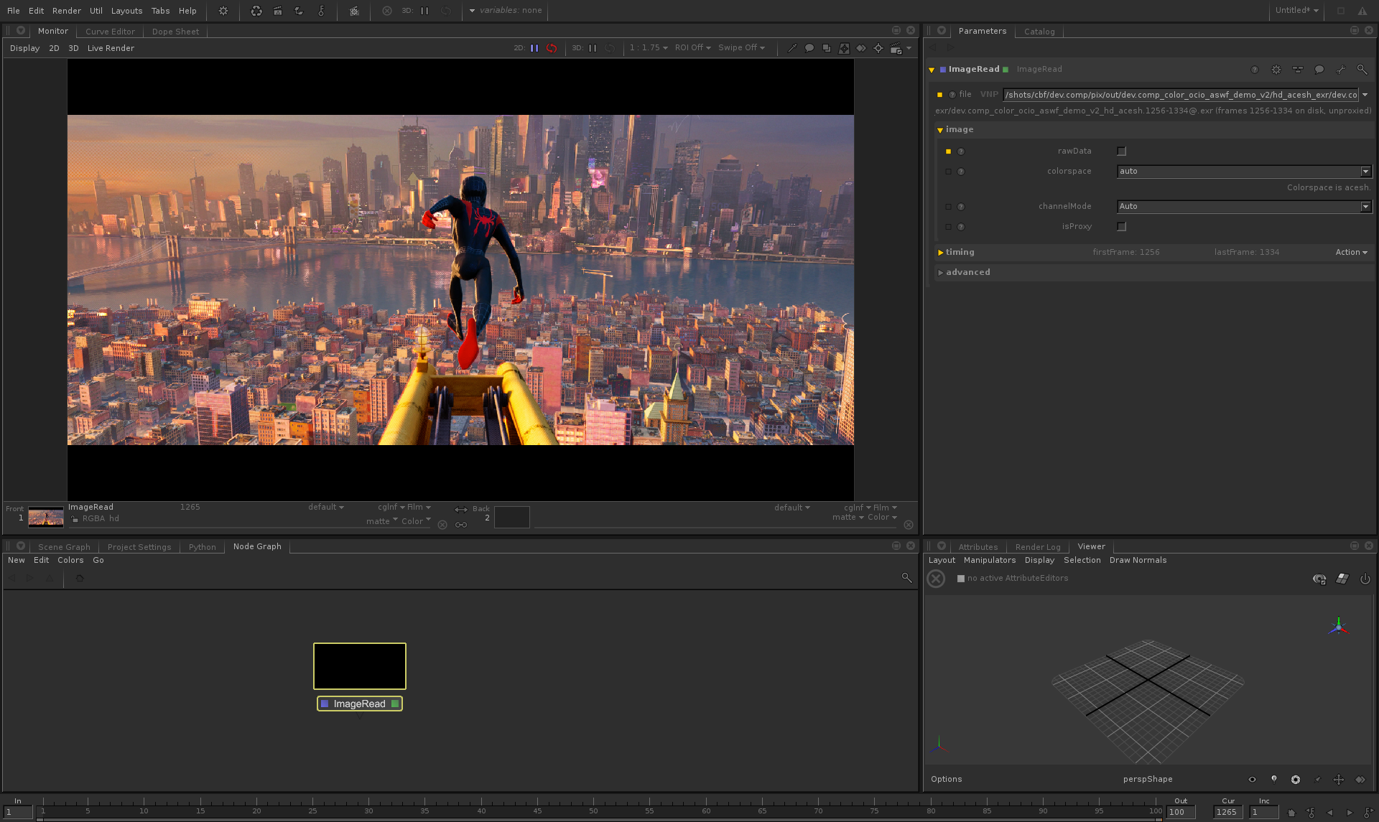
Nuke
Spider-Man™: Into the Spider-Verse; all images courtesy of Imageworks
Joined ASWF in Feb. 2019; adopted status in Nov. 2019.
Developed by Sony Pictures Imageworks in 2003.
Provides a consistent user experience across digital content creation applications; widely adopted in VFX and computer animation studios and software.
Academy Technical Achievement Award recipient.
Key contributors include Imageworks, Autodesk, DNEG, ILM, Foundry, Framestore.
OCIO v2 coming this summer, led by Autodesk.
Katana
github.com/AcademySoftwareFoundation/OpenColorIO
Notes:
Top image is in Foundry’s Nuke, bottom in Foundry’s Katana

Slide 13
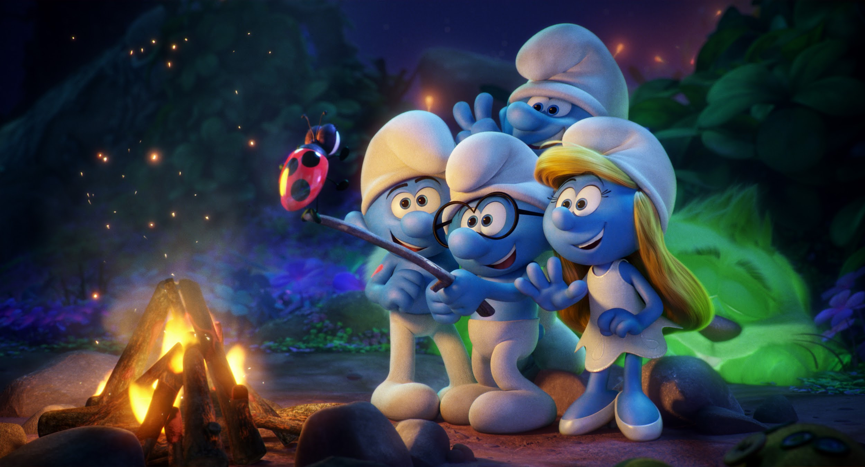
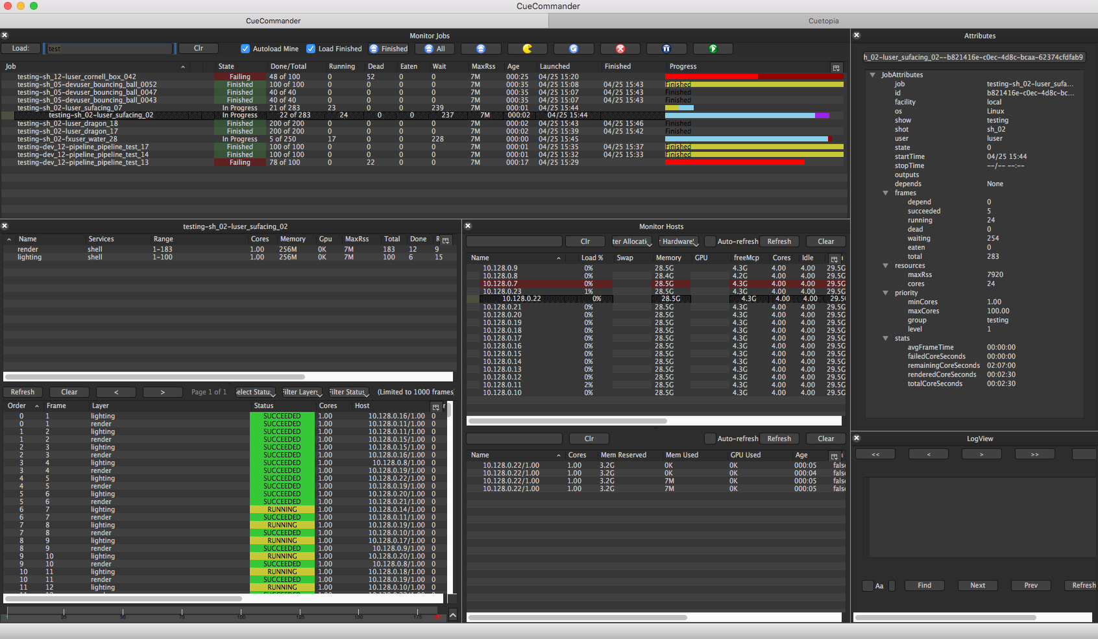

Smurfs: The Lost Village; courtesy of Sony Pictures Imageworks
OpenCue screenshot
Joined ASWF in April 2019.
Developed at Sony Pictures Imageworks as its internal render farm manager (“Cue3”); collaboration with Google Cloud to release as OpenCue in January 2019.
Fully featured render manager for media and entertainment that can be used to break down complex jobs into individual tasks.
Contributors include Imageworks, Google, Netflix, Microsoft, Amazon.
Monthly releases over the past year, including adding Python 3 compatibility, Windows support, new documentation.
github.com/AcademySoftwareFoundation/OpenCue

Slide 14
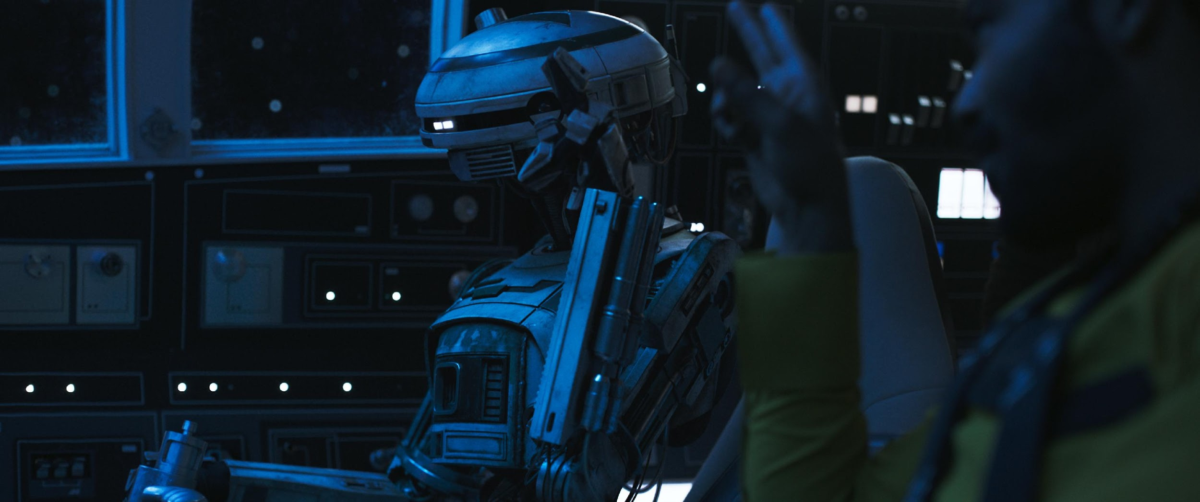
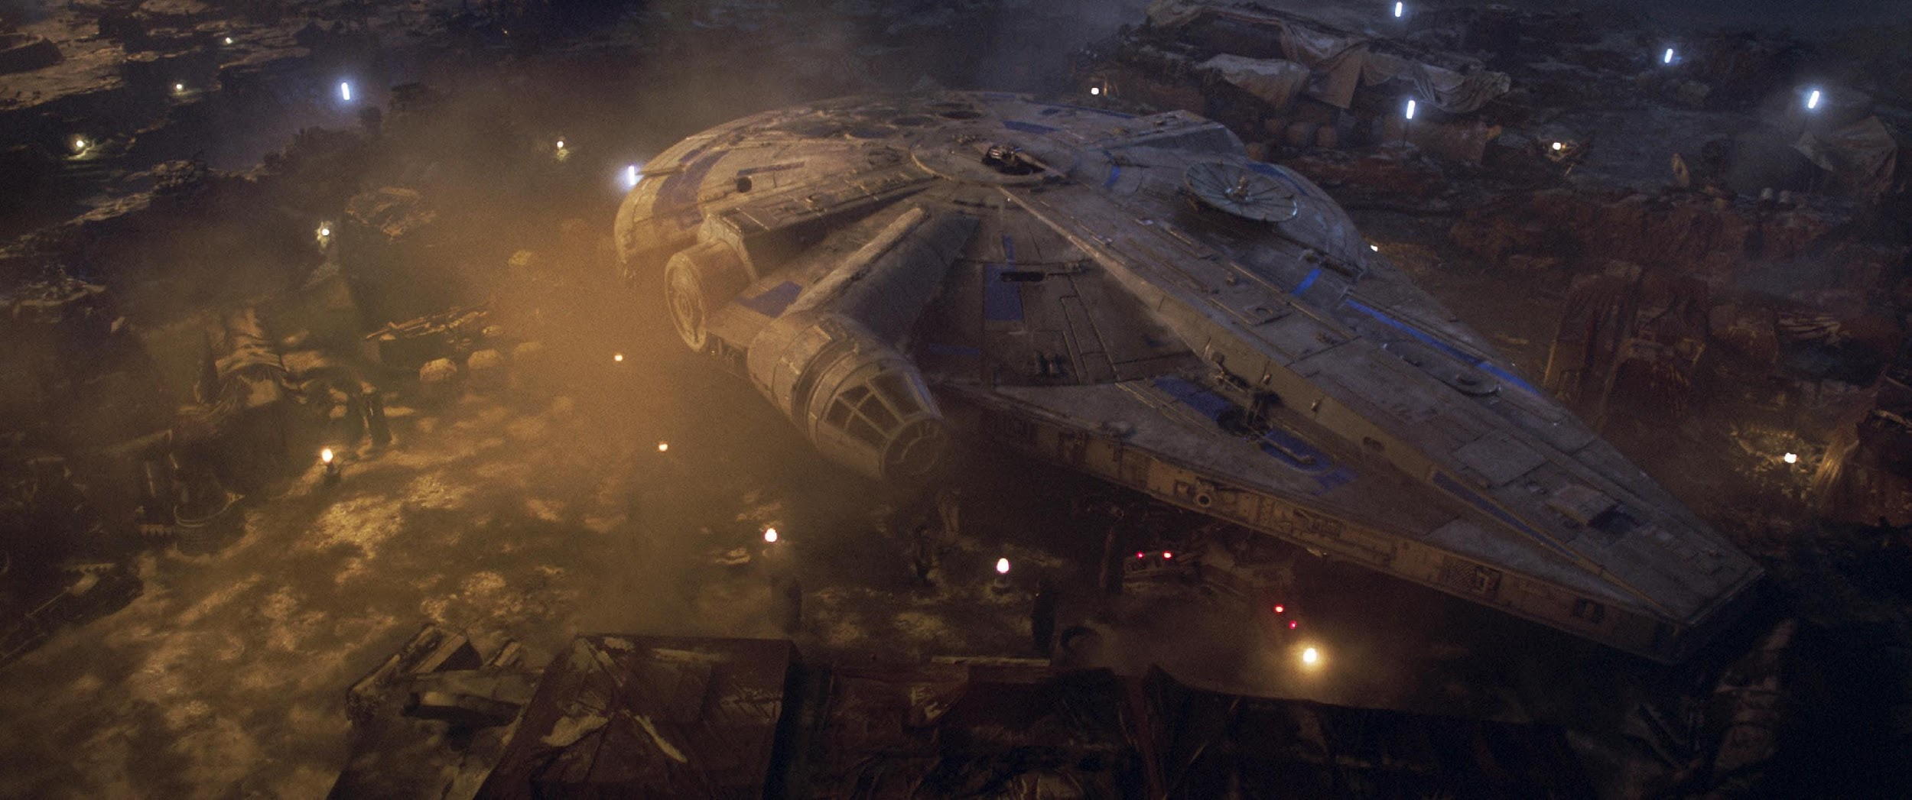
Images from Solo: A Star Wars Story. © and TM Lucasfilm Ltd. All Rights Reserved.
Joined ASWF in April 2019; adopted status in Nov. 2019.
Developed by ILM in 1999; first release of a major open source project by a studio.
High dynamic-range (HDR) image file format for high-quality image processing and storage; widely adopted standard in computer graphics.
Academy Technical Achievement Award recipient.
Key contributors include ILM, Disney Animation, Imageworks, Epic Games, Weta Digital, Pixar, Autodesk, and DreamWorks.
OpenEXR 3.0 release coming later this summer.
github.com/AcademySoftwareFoundation/OpenEXR

Slide 15
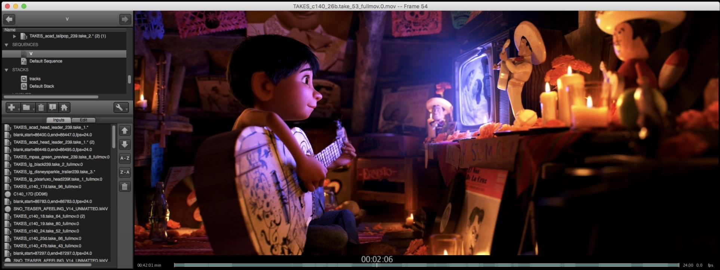

OpenTimelineIO used on Coco for transitions and linking media to the latest renders.
Image courtesy of Pixar Animation Studios.
Joined ASWF in July 2019.
Developed by Pixar Animation Studios.
Open source interchange format for editorial timeline information – clips, timing, tracks, transitions, metadata etc.
Key contributors include Pixar, Netflix, DreamWorks, Autodesk.
Still in Public Beta; Beta 12 released in March 2020.
github.com/PixarAnimationStudios/OpenTimelineIO

Slide 16

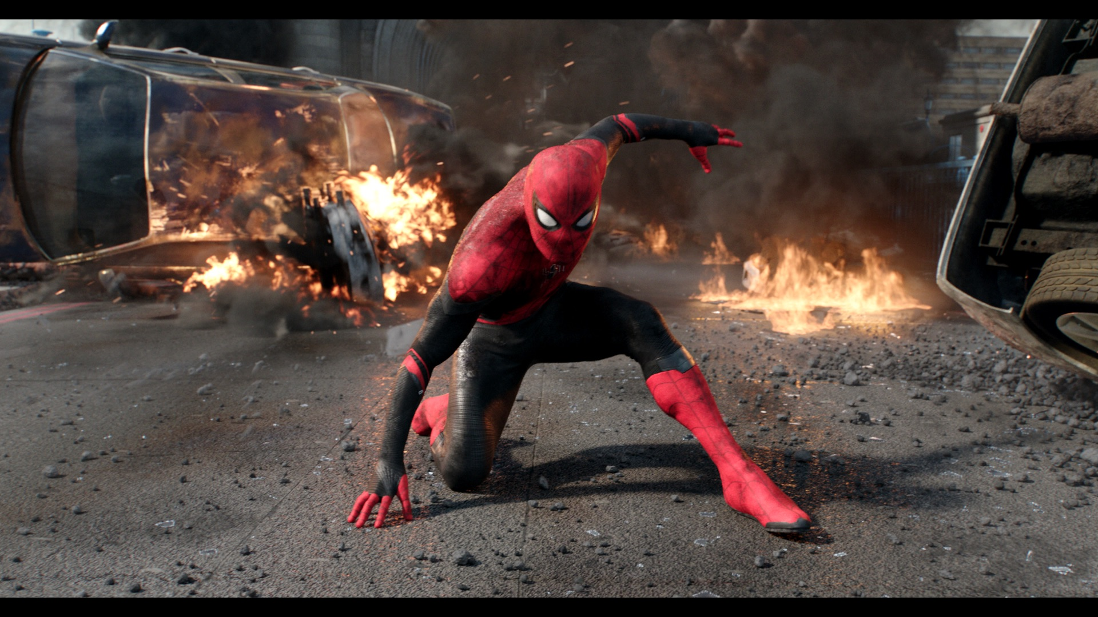

The Angry Birds Movie 2; courtesy of Imageworks
Spider-Man: Far From Home; courtesy of Imageworks
Joined ASWF in April 2020.
Developed by Sony Pictures Imageworks; released as open source in 2010.
De facto standard shading language for VFX and animation, ideal for describing materials, lights, displacement, and pattern generation.
Academy Technical Achievement Award recipient.
Key contributors include Imageworks, Animal Logic, NVIDIA, Pixar, DNEG, Autodesk.
Open Shading Language
github.com/Imageworks/OpenShadingLanguage

Slide 17
How to Contribute
Contribute to an existing project:
Submit a PR with a bugfix or new feature
Pick existing GitHub issue as a sample project
Integrate with a new app / contribute plugin
Help improve project documentation
Submit additional test cases
Join the TSC discussion: dev mailing list, conf calls
Get involved with the TAC:
DevOps / CI expertise always useful
Interest / expertise in security especially welcome
Join the TAC discussions: mailing list, conf calls, working groups

Slide 18
Join the Discussion
Mailing Lists for ASWF projects: lists.aswf.io
Join as a member: aswf.io/join
Slack: slack.aswf.io
Github: github.com/AcademySoftwareFoundation
Behind the Screens: bit.ly/BehindtheScreens
Twitter: @AcademySWF, #ASWF
YouTube: AcademySoftwareFoundation

Slide 19
How To Participate
Developers can join our mailing lists to stay informed
about the code and our projects at lists.aswf.io.
Learn how your organization can support the ASWF community at aswf.io/join.
Stay connected to us on Twitter at
@AcademySWF and #ASWF

Slide 20
Thank you!

